Slide 1
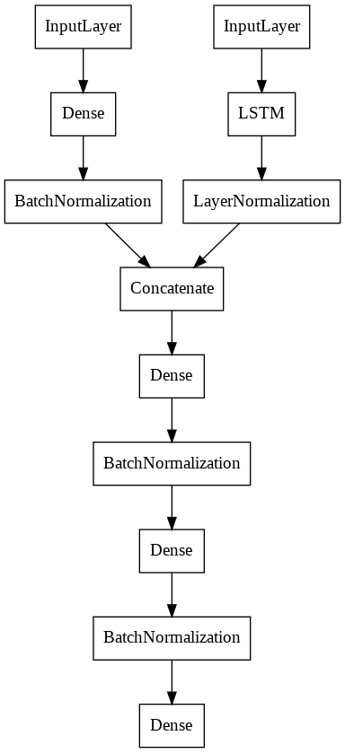
RNN Architecture
Event level data
Object level data

Slide 2
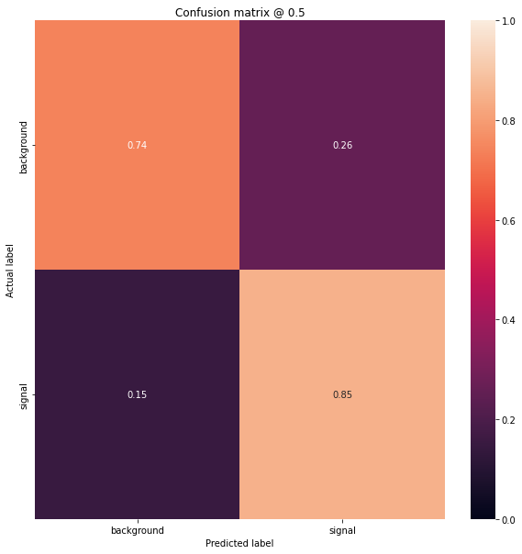
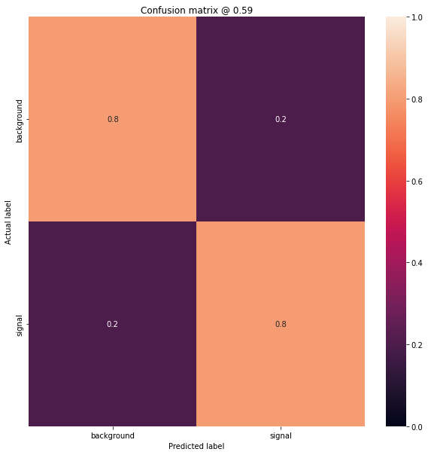
Confusion matrix at p=0.5
Confusion matrix at p=0.59 (balanced)

Slide 3
